Slide 1


Contained Availability Group New in SQL Server 2022

Slide 2



What is the problem?
How do we sync these?
SQL Agent Jobs
Logins and permissions
Linked Servers
Alerts
Operators
etc. (anything stored in master and msdb)
SQL AG Replica 1
SQL AG Replica 2
DB
DB
Availability Group
DB
DB
Synchronization
DB
DB
Job1
Job2
Job3
Availability Group
Job1
Job2
Job3
Synchronization
Login1
Login2
Login3
Login1
Login2
Login3

Slide 3
Introducing Contained AG
You can now sync the following:
SQL Agent Jobs
Logins and permissions
Linked Servers
Alerts
Operators
In other words, sync…
Objects in master and msdb!
SQL AG Replica 1
SQL AG Replica 2
DB
DB
Availability Group
DB
DB
Synchronization
DB
DB
Job1
Job2
Job3
Availability Group
Job1
Job2
Job3
Synchronization
Login1
Login2
Login3
Login1
Login2
Login3

Slide 4
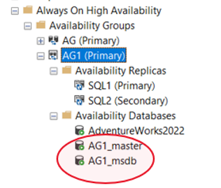
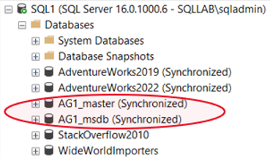
The Secret Sauce (Contained system DBs)
Your AG now has its own master and msdb to store logins, jobs, etc., within the availability group itself.
These Contained AG system databases will synchronize along with the availability database across all your AG replicas.
The AG master and msdb are actually template copies of the “real” global master and msdb.

Slide 5
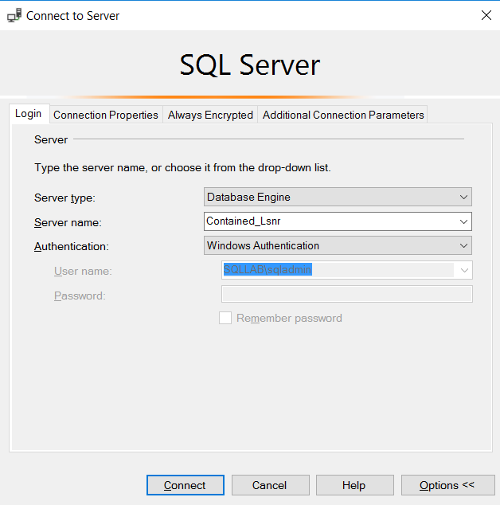
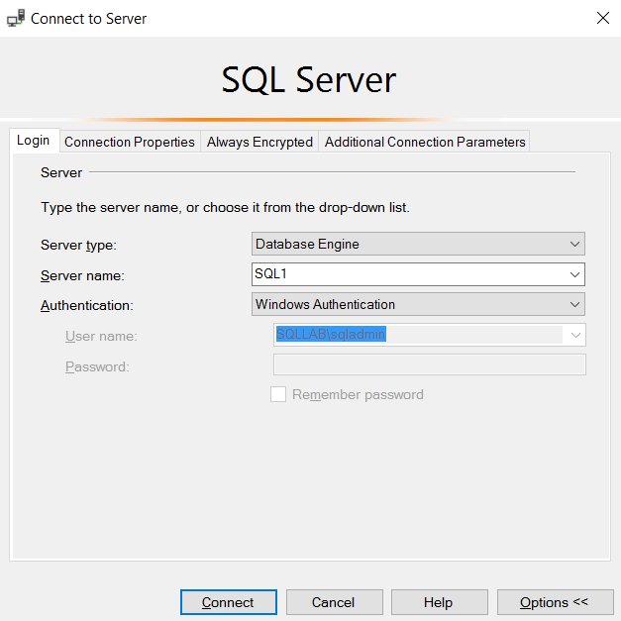
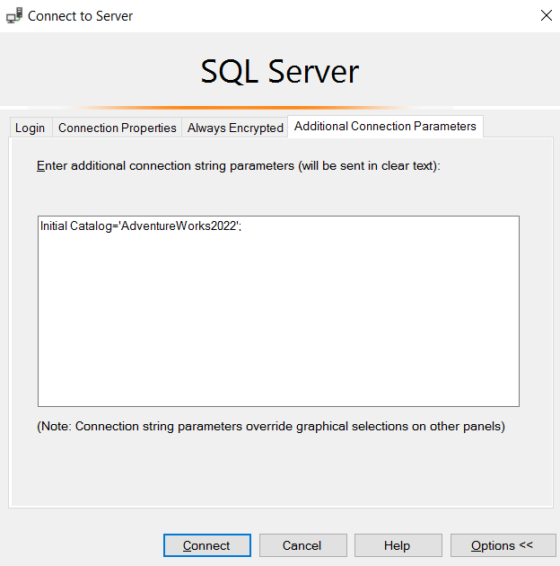
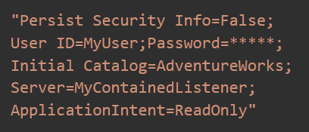
Connecting to Contained AG
When you create a Contained AG, you essentially create a “local” space within SQL Server – a space that contains everything that the application using the AG would need, whether it be database or instance-level objects.
Connecting to the Contained AG is key to ensuring you are interacting with this “local” space and NOT with the “global” Instance of SQL Server. For example, when you are connected to the Contained AG and you create a login, that login will be stored in the Contained AG master database, which will then be replicated across your AG replicas.
How do you then ensure you’re connected to the Contained AG?
Using the Contained AG Listener name
Using the servername and specifying the Contained AG database as the “Initial Catalog”
For Read-only routing, in addition to using the listener, you need to specify the Contained database as “Initial Catalog”

Slide 6
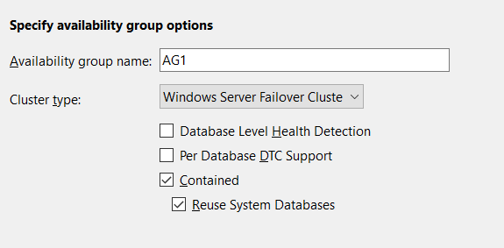
Create Contained AG (via UI)
IMPORTANT NOTE: UI option is only available in SSMS 19.x and above

Slide 7
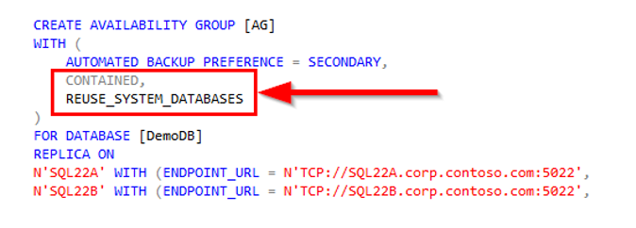
Create Contained AG (via T-SQL)

Slide 8
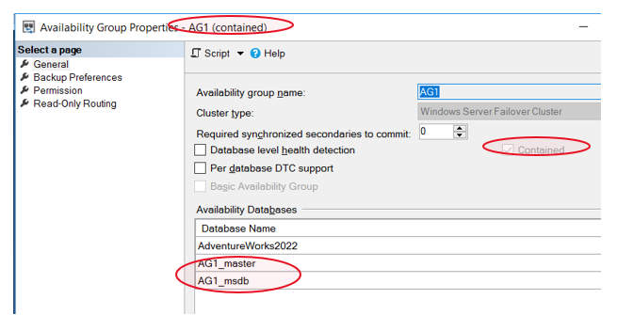
How else can I tell if AG is “Contained”

Slide 9
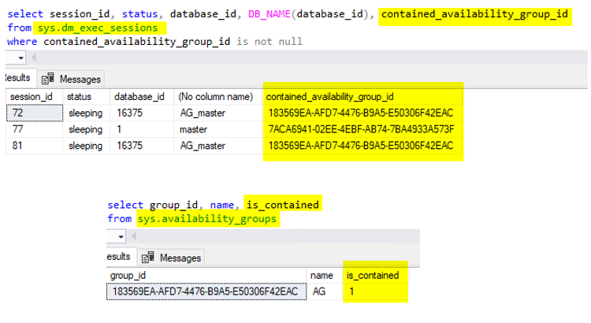
Contained AG Metadata

Slide 10

Demo

Slide 11
Some nuances to consider
When connected to contained AG, users will only see databases in the contained AG, plus tempdb. That said, non-contained databases can still be accessed using a 4-part name or USE command.
At instance level, contained AG master and msdb names will be [contained AG]_master, and [contained AG]_msdb. Inside contained AG, their names are master and msdb.
Database ID for contained AG master is 1 from inside contained AG, but something else when connected to the external instance.
Server configuration through sp_configure can be read from contained AG connection but can only be written from instance level
From contained AG connections, sysadmin is able to perform instance level operations, such as shutting down SQL Server. Contained AG is NOT a security boundary!

Slide 12
How does it play with other features?
SUPPORTED
UNSUPPORTED
Change Data Capture (CDC)
Log Shipping (of Primary)
Transparent Data Encryption (TDE)
Replication (all types)
Log Shipping (of Secondary)
Distributed AG
Want to learn more about Contained AG’s interoperability?
What is a contained availability group? - SQL Server Always On | Microsoft Learn

Slide 13

FAQs
What are the benefits of using Contained AG?
Simplifies the management of metadata objects and configuration settings across replicas, reducing the risk of errors and inconsistencies.
What are the limitations or challenges of using a contained availability group?
The contained availability group feature is only supported in SQL Server 2022 or later versions, and it is not compatible with earlier versions of SQL Server or other database platforms.
Improves the availability and resilience of applications that rely on the availability group, as the contained system databases are also protected by the availability group mechanism.
Facilitates the scaling and migration of availability groups, as you can easily add or remove replicas without having to manually synchronize the metadata objects and configuration settings.
The contained availability group feature requires additional storage space and network bandwidth, as the contained system databases are also replicated across the replicas.
The contained availability group feature may conflict with some existing features or functionalities, such as database mirroring, log shipping, replication, or backup and restore operations.
How can I monitor and troubleshoot a contained availability group?
You can use the same tools and methods that you use for regular availability groups, such as the Always On dashboard, the Availability Group Wizard, the Availability Group Properties dialog box, the sys.availability_groups and sys.dm_hadr_availability_group_states dynamic management views, the sp_help_availability_group and sp_help_availability_group_cluster stored procedures, and the SQL Server error log. Additionally, you can use the sys.contained_availability_groups and sys.dm_hadr_contained_availability_group_states dynamic management views, and the sp_help_contained_availability_group stored procedure, to get information specific to the contained availability group feature.
Can the Contained AG system databases be backed up and restored?
Yes. You can back up and restore the master and msdb in the Contained AG just as if they are regular user databases.
Can the Contained AG system database files be moved to a different file system location?
Yes.

Slide 14

Thank you!

